Slide 1
Operating Systems
3. Process Scheduling
3-Scheduling
1

Slide 2
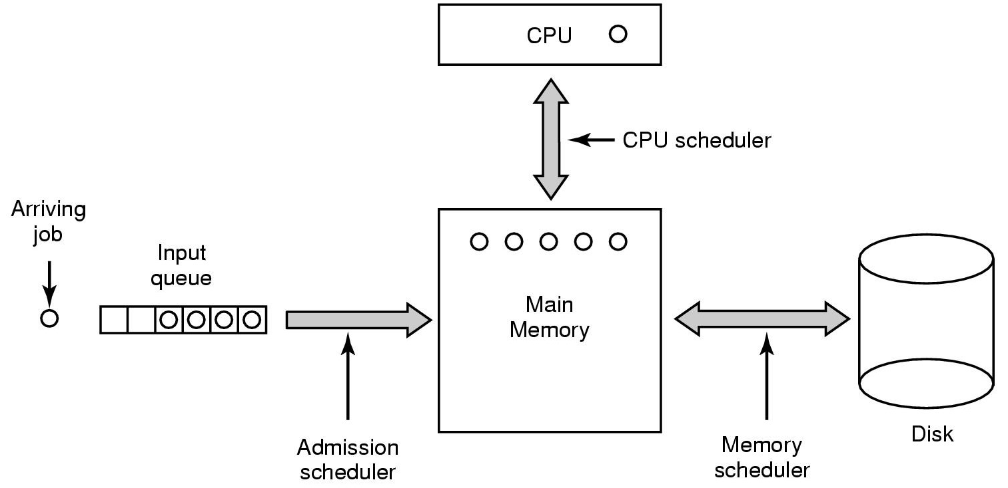
Three Level Scheduling
3-Scheduling
2

Slide 3
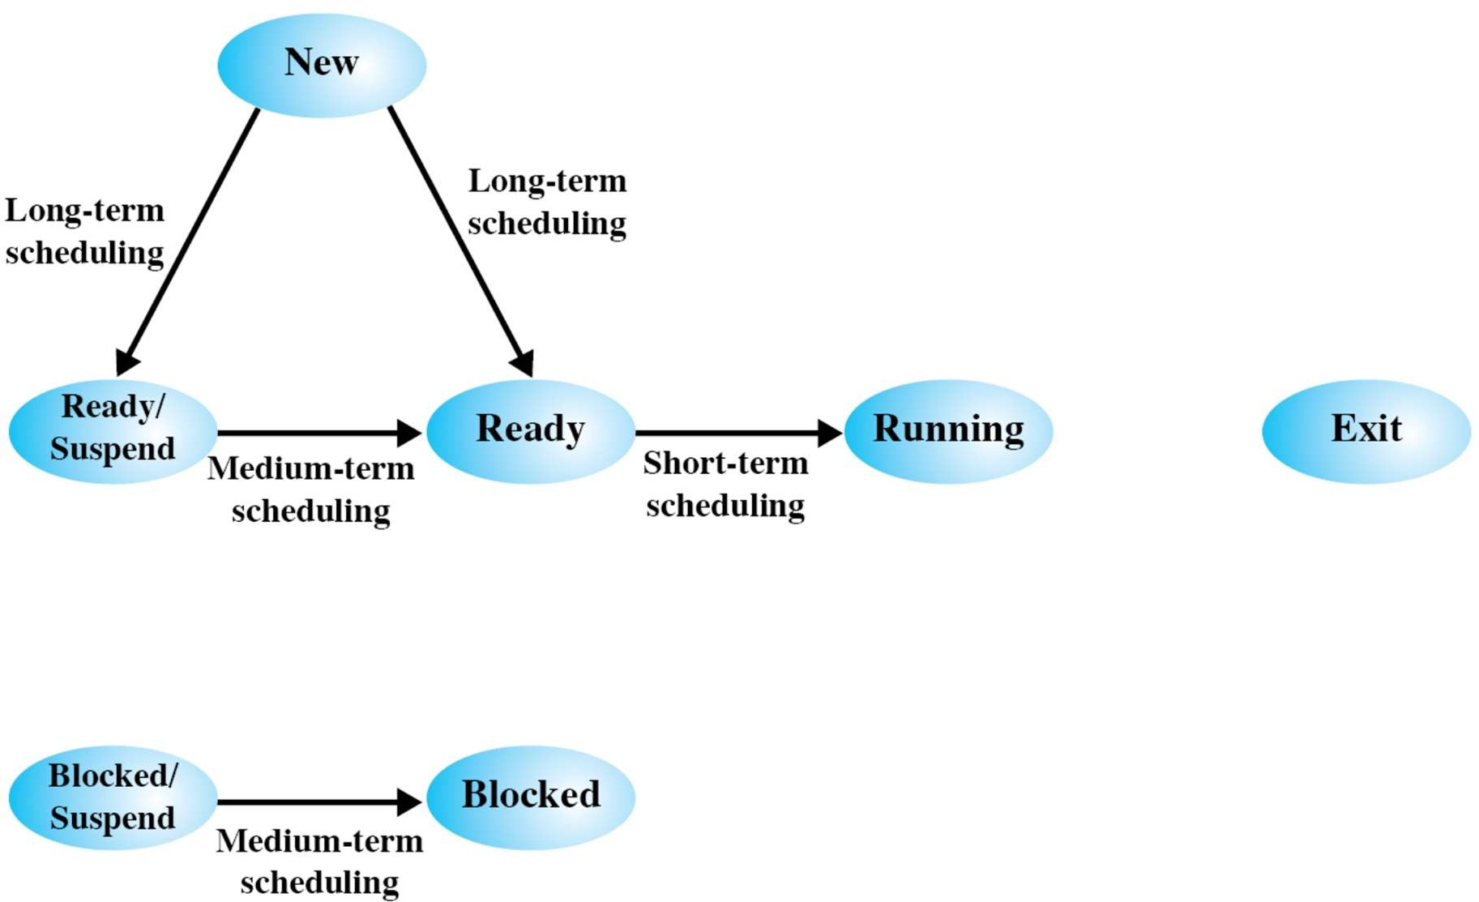
Scheduling and Process Transitions
3-Scheduling
3

Slide 4
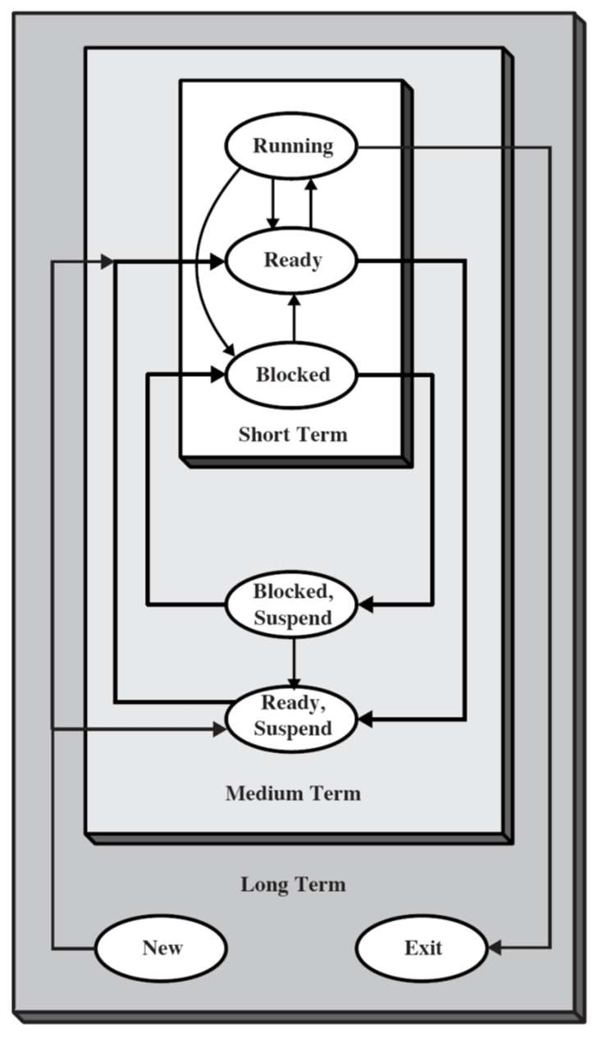
Long- and Medium-Term Schedulers
Long-term scheduler
Determines which programs are admitted to the system
I.e., to become processes
Requests can be denied
E.g., in case of thrashing or overload
Medium-term scheduler
Decides when/which processes to suspend/resume
Both control the degree of multiprogramming
More processes, smaller percentage of time each process is executed
3-Scheduling
4

Slide 5
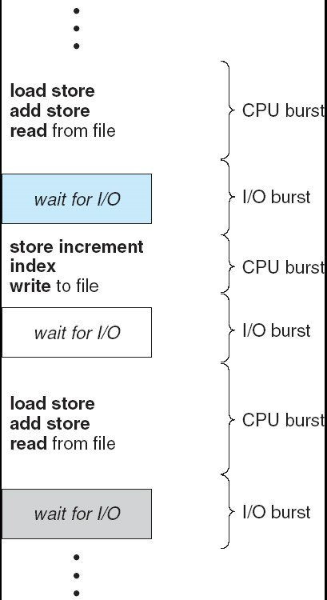
CPU–I/O Burst Cycle
Process execution consists of a cycle of
CPU execution and
I/O wait
A process may be
CPU-bound : Long CPU bursts
IO-bound : Short CPU bursts
3-Scheduling
5

Slide 6

Short-Term Scheduler: Selection of a New Process
Four cases
2. Interrupt occurs, move from Running to
Ready
Release
Exit
Dispatch
Admit
New
Ready
Running
Time-out
Event occurs
3. Event I/O Completion, exit(0), semaphore acquire
Event wait
1. Wait for I/O, waitpid(), semaphore
etc.
Blocked
4. A Process terminates
3-Scheduling
6

Slide 7
Decision Mode
Non preemptive
Once a process is in the running state, it will continue until it terminates or blocks itself for I/O, child process, semaphore etc.
Preemptive
Currently running process may be interrupted
Now transition from Running to Ready state possible
Prevents a single process to monopolize the processor for very long
3-Scheduling
7

Slide 8
Non Preemptive Scheduling
Only the case 1 and 4
Dispatch
Release
Admit
New
Ready
Running
Exit
Time-out
4. A Process terminates
Event occurs
Event wait
1. Wait for I/O, waitpid(), semaphore
etc.
Blocked
3-Scheduling
8

Slide 9
Preemptive Scheduling
All four cases possible
2. Interrupt occurs, move from Running to
Ready
Release
Exit
Dispatch
Admit
New
Ready
Running
Time-out
Event occurs
3. Event I/O Completion, exit(0), semaphore acquire
4. A Process terminates
Event wait
1. Wait for I/O, waitpid(), semaphore
etc.
Blocked
3-Scheduling
9

Slide 10

Preemptive Scheduling
In case of 2 and 3, there is a choice
Whether to continue, with the same process
Or select a new one from the ready queue
2. Interrupt occurs, move from Running to
Ready
Release
Exit
Dispatch
Admit
New
Ready
Running
Time-out
Event occurs
3. Event I/O Completion, exit(0), semaphore acquire
Event wait
Blocked
3-Scheduling
10

Slide 11
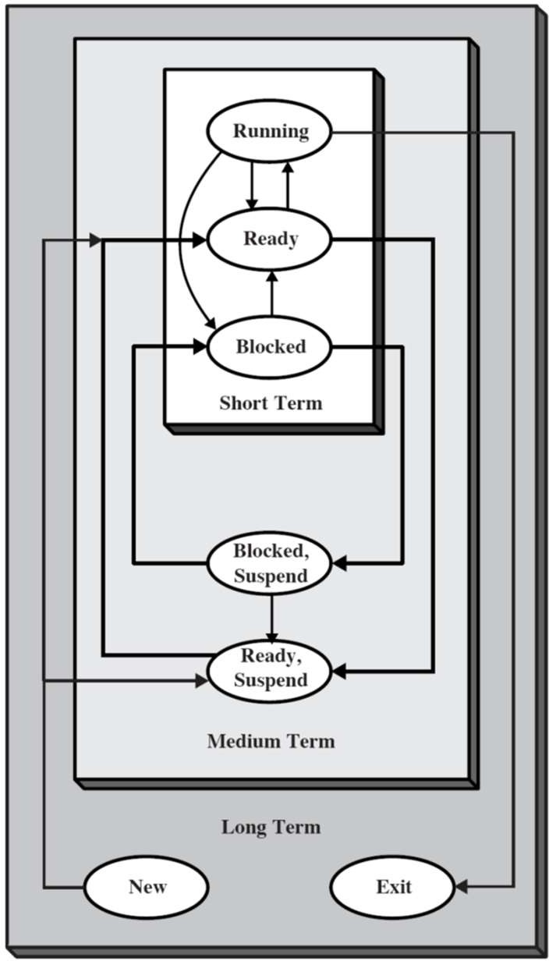
Short-Term Scheduler
Decides which process will be dispatched
Invoked upon Clock interrupts, I/O interrupts, Operating system calls, Signals
Dispatch latency: Period of time the dispatcher needs to stop one process and start another running
Dominating factors
Switching context
Selecting a process to dispatch
Arrival time: Time when a process is admitted to the system
Service Time: Period of time a process executes in running state

Slide 12
Scheduling Issues
Fairness
Don’t starve process
Priorities
Most important first
Deadlines
Task X must be done by time t
Optimization
Throughput, response time
Scheduler Efficiency
Overhead, e.g., context switching, computing priorities, …
Reality - No universal scheduling policy
Many models

Slide 13
Scheduling Criteria and Optimization goals
CPU utilization
Percentage of time CPU is busy
Keep CPU as busy as possible
Throughput
No. of processes that complete their execution per time unit
Turnaround time (TAT)
Amount of time to execute a particular process
TAT = Time of completion – Arrival time
Execution + all the waiting for resources including CPU
Involves also the IO schedulers
Not a good criteria for interactive systems

Slide 14
Scheduling Criteria and Optimization goals
Waiting time
Waiting Time = Sum of the periods spent waiting in the Ready queue
Scheduling Algorithm does not effect the waiting time in Block queue
Only effect the waiting time in the Ready queue
Waiting time = turnaround time – burst time
Response time
Amount of time from submission of the request until first response
Response time = First response – Arrival time
Execution + waiting time in ready queue
Summary
Maximize: CPU utilization, Throughput
Minimize: Turnaround time, Waiting time, Response time

Slide 15
First-Come-First-Served (FCFS)
Wait time depends on arrival order
Worst case: long job arrives first
Example: Three processes with service times: A=100, B=1, C=2
– Case 1: Processes arrive in the order A, B, C
A
C
B
time 100 101 1 03
Average Waiting Time = (0 + 100 + 101) / 3 = 67
– Case 2: Processes arrive in the order B, C, A
B C
A
time 1
3
Average Waiting Time = (0 + 1 + 3) / 3 = 1.33
103

Slide 16
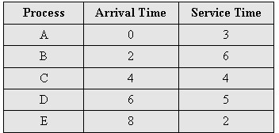
First-Come-First-Served (FCFS)
Non-preemptive
Favors CPU-bound processes
A short process may have to wait very long before it can execute
Convoy effect – Many I/O processes may stuck behind CPU-bound process
Burst Time
0
5
10
15
20
A
B C D E

Slide 17
First-Come-First-Served (FCFS) – Convoy Effect
Consider one CPU-bound and many I/O-bound processes
The CPU intensive process blocks the CPU
A number of I/O intensive processes stuck behind this process
Leaving the I/O devices idle
Low I/O device utilization
When the CPU-bound process finally issues I/O request
I/O processes pass through the CPU quickly
Leaving the CPU idle while everyone queues up for I/O
The cycle repeats itself when the CPU intensive process gets back to the ready queue

Slide 18
Shortest Job First (SJF) – Non-preemptive
0
5
10
15
20
A
B C D E
Burst Time
Associate with each process the length of its next CPU burst
– Short process jumps ahead of longer processes
Avoid convoy effect

Slide 19
SJF (Non-preemptive) – Example
Process | Burst time
P₁ | 6
P₂ | 8
P₃ | 7
P₄ | 3
P₄
P₁
P₃
P₂
0
3
9
16
24
Average waiting time = (3 + 16 + 9 + 0) / 4 = 7

Slide 20
SJF (Non-preemptive) – Example
Process | Arrival time | Burst time
P₁ | 0 | 7
P₂ | 2 | 4
P₃ | 4 | 1
P₄ | 5 | 4
P₁
P₃
P₂
P₄
0 3
Average waiting time
– (0 + 6 + 3 + 7)/4 = 4
7 8
12
16

Slide 21
Shortest Remaining Time First – Example
Process | Arrival time | Burst time
P₁ | 0 | 7
P₂ | 2 | 4
P₃ | 4 | 1
P₄ | 5 | 4
P₁
P₂
P₃
P₂
P₄
P₁
0
2 4 5
7
11
16
Average waiting time
– (9 + 1 + 0 + 2)/4 = 3

Slide 22
Shortest Remaining Time First – Example
Process | Arrival time | Burst time
P₁ | 0 | 8
P₂ | 1 | 4
P₃ | 2 | 9
P₄ | 3 | 5
P₁
P₂
P₄
P₁
P₃
0
1 5 10
Average waiting time
– [(10-1)+(1-1)+(17-2)+5-3)]/4 = 26/4 = 6.5
17
26

Slide 23
Performance of SJF Scheduling
Gives high throughput
Gives minimum average waiting time for a given set of processes
FCFS: P1:
P2:
P3:
Run
I/O
Run
Ready
Run
I/O
Ready
Ready
R
I/O
Ready
SJF: P1:
P2:
P3:
Ready
Run
I/O
Rd Run
I/O
Run
I/O
R
I/O
Rd R
I/O
R
Time

Slide 24
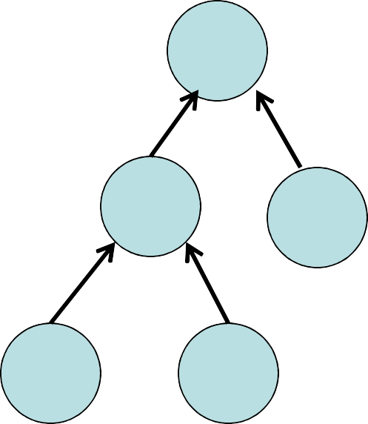
Dispatcher Performance: SJF
Dispatcher utilizes heap operations
Enqueue: insert_heap(P_{i}, t_{i} )
Dequeue: del_min()
Decrease the priority dynamically
Performance depends on implementation
Binary Heap
Insert : O(log₂ n)
Dequeue: O(log₂ n)
10
20
30
25
45

Slide 25
Shortest Remaining Time First
Shortest Job First (SJF) can be preemptive or non-preemptive
Preemptive SJF is also called Shortest Remaining Time First
Overall Idea
While an existing process is executing
A new process arrives at the ready queue
Existing process is preemptive
If the CPU burst of the newly arrived process is shorter than the remaining execution time of existing process

Slide 26
Properties of SJF
Possibility of starvation for longer processes
Must estimate length of next CPU burst
Need for an algorithm that adapts the estimate dynamically
Algorithm must deal with variable length of CPU bursts
Exponential averaging
What if estimates are not correct?
Preemption by the operating system

Slide 27
Simple Averaging VS Exponential Averaging:
Simple Averaging
In simple averaging, there are given list of n processes P(i).......P(n). Let T(i) denotes the burst time of the process P(i). Let τ(n) denotes the predicted burst time of Pth process. Then according to the simple averaging, the predicted burst time of process n+1 will be calculated as,
τ(n+1) = (1/n) ∑ T(i)
Exponential Averaging:
Let, Tn be the actual burst time of nth process.τ(n) be the predicted burst time for nth process then the CPU burst time for the next process (n+1) will be calculated as,
τ(n+1) = α . Tn + (1-α ) . τ(n)
Where, α is the smoothing. Its value lies between 0 and 1.

Slide 28
Round Robin – Example with Time Quantum = 4
Process | Burst time
P₁ | 24
P₂ | 3
P₃ | 3
Process may have CPU burst of less than 1 time quantum
Process itself release the CPU voluntarily
Dispatcher will proceed to the next process in ready queue
P₁
P₂
P₃
P₁
P₁
P₁
P₁
P₁
0
4
7
10
14
18 22
26
30

Slide 29
Round Robin
0
5
10
15
20
A
B C D E
Burst Time
Preemption based on clock (interrupts on time slice or quantum -q- usually 10-100 msec)
Fairness: for nprocesses, each gets 1/n of the CPU time in chunks of at most q time units
Performance
q large ⇒ FCFS
q small ⇒ overhead can be high due to context switches

Slide 30
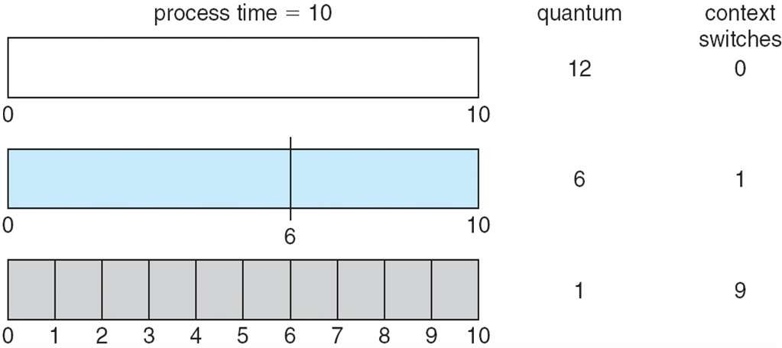
Time Quantum and Context Switch Time
Quantum –q- should be large compared to context switch time
Quantum –q- usually 10ms to 100ms, context switch < 10 usec

Slide 31
Round Robin
Low average waiting time when job lengths vary
Example: Three processes with service times: A=100, B=1, C=2
1 2 3 4 5
103
CPU
A
B C
C
A
A
time
Average waiting time
– (3 + 1 + 3) / 3
Average completion (Turn around time)
– (103 + 2 + 5) / 3

Slide 32
Round Robin – Disadvantage
Good for Varying sized jobs
But what about same-sized processes?
Example: Two processes with same service time =100
1 2 3 4 5
199 200
A
B
A
B
A
A
B
A
B
CPU
time
Average completion time, i.e., Turn Around Time (TAT)?
– (200 + 200) / 2 = 200
How does this compare with FCFS for same two jobs?
– (100 + 200) / 2 = 150

Slide 33
Dispatcher Performance: Round Robin and FCFS
Maintain linked list
Dequeue: Remove head
Enqueue: Append tail
Cost
Enqueue: O(1)
Dequeue: O(1)
P_{n}
^{P}n-1
P₂
P₁
…

Slide 34
Priority Scheduling
Scheduler can choose a process of higher priority over one of lower priority
Can be preemptive or non-preemptive
Priorities can be static or dynamic
E.g., in SJF priority is the predicted next CPU burst time
Problem of priority based schemes: Danger for starvation
Low priority processes may never execute
E.g., process with a long CPU burst in SJF may never execute
A solution: Aging
As time advances the priority of a process is increased
Longest running processes eventually reaches highest priority

Slide 35
Priority Scheduling – Example
Process | Priority | Burst time
P₁ | 3 | 10
P₂ | 1 | 1
P₃ | 4 | 2
P₄ | 5 | 1
P₅ | 2 | 5
P₂
P₅
P₁
P₃
P₄
0
1
6
16
18 19
Average waiting time = 8.2

Slide 36
Priority Scheduling
If processes have equal priority
Round robin
FCFS
I/O Bound vs. CPU Bound
Which type of processes should be given Higher Priority
In order to keep I/O busy increase priority for jobs that often block on I/O

Slide 37
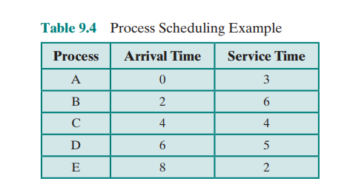
Highest Response ratio next
R = (w + s)/s where R = response ratio, w = time spent waiting for the processor, and s = expected service time

Slide 38
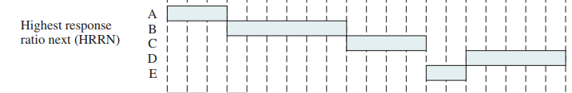
Highest Response ratio next

Slide 39
Why?
This approach is attractive because it accounts for the age of the process. While shorter jobs are favored (a smaller denominator yields a larger ratio), aging without service increases the ratio so a longer process will eventually get past competing shorter jobs.
As with SRT and SPN, the expected service time must be estimated to use highest response ratio next (HRRN).

Slide 40
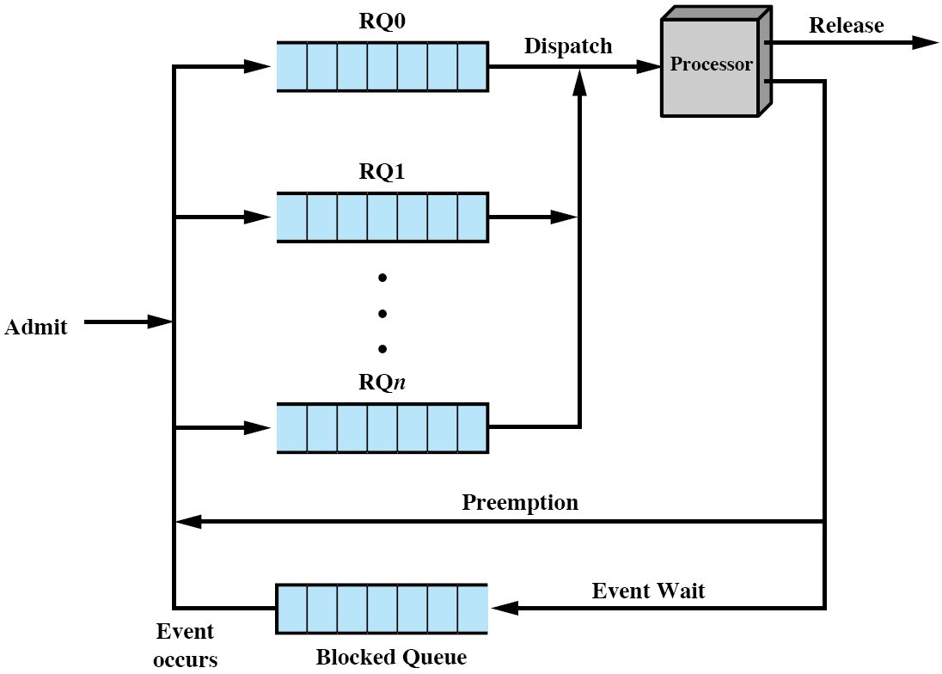
Multilevel Queue
Idea: Reduce dispatch latency by multilevel queues
Ready queue is partitioned into separate queues, e.g.,
Foreground (interactive)
Background (batch)
Scheduling algorithm for each queue, e.g.,
Foreground → RR
Background → FCFS
And scheduling between queues
…

Slide 41
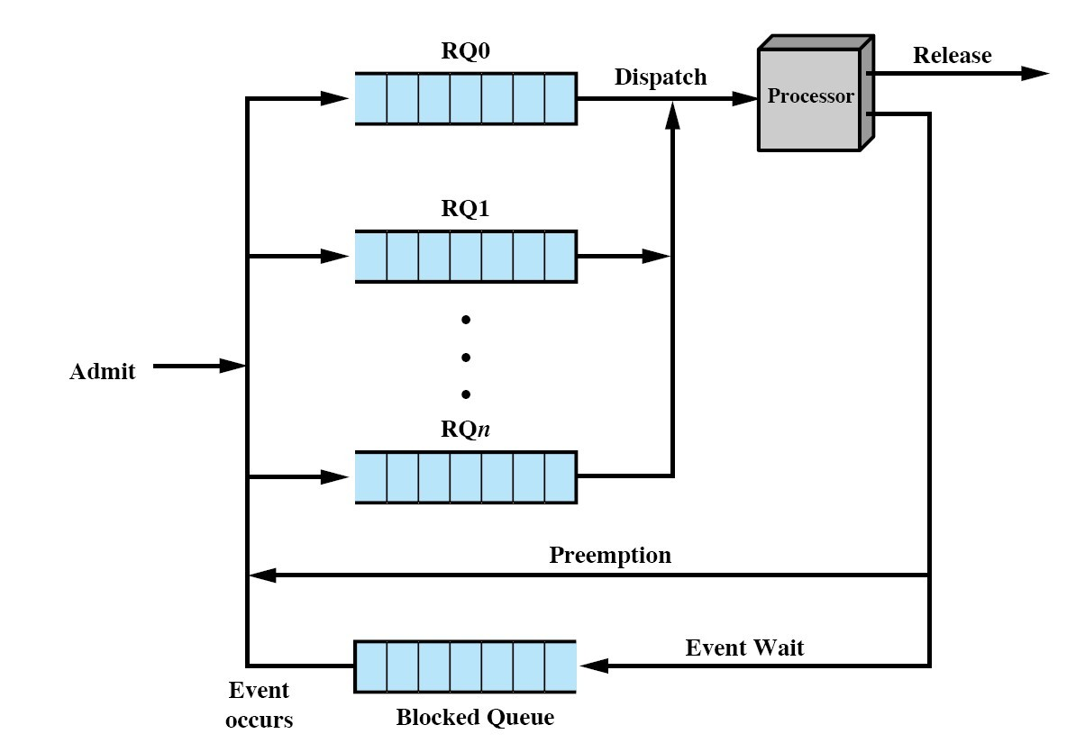
Multilevel Queues: Scheduling Between the Queues
Fixed order/priority e.g.,
Serve all from foreground then from background
Possible starvation
Time slice
Each queue gets a fraction of CPU time to divide amongst its processes, e.g.,
80% to foreground in RR
20% to background in FCFS

Slide 42










Multilevel Queue Scheduling – Example
Highest Priority
System Processes
Interactive Processes Interactive editing Processes Batch Processes
Student Processes
39
Lowest Priority

Slide 43
Multilevel Feedback Queue
A process can move between the various queues
Aging can be implemented this way
Scheduling parameters
Number of queues
Scheduling algorithms for each queue
Method to upgrade a process
Method to demote a process
Method used to determine which queue a process enters first

Slide 44
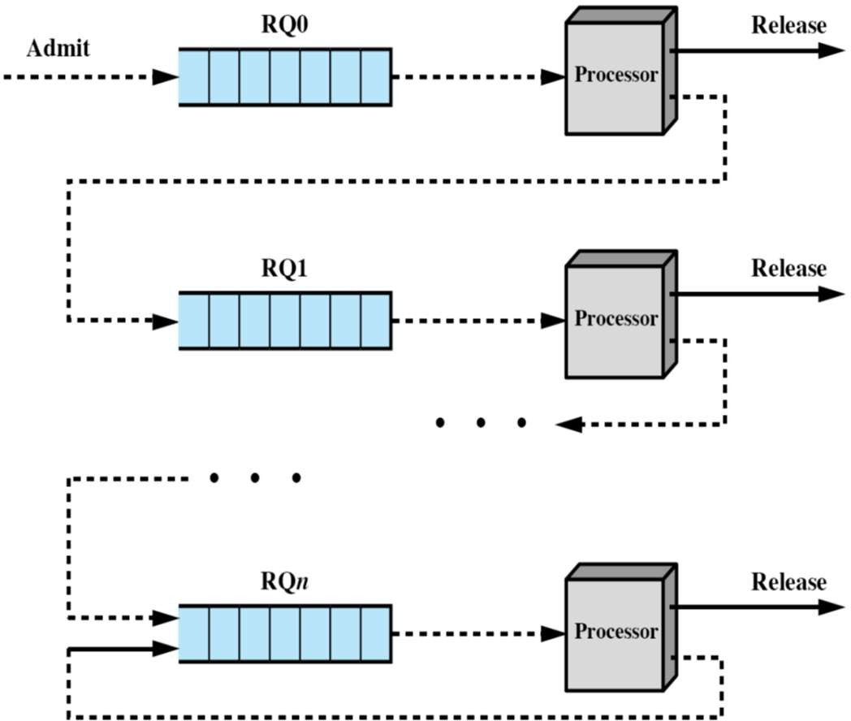




Approximation of SJF: Multilevel Feedback Queue
Admission of _{i}:
Assign process to
Dispatch()
i
0
Find smallest level s.t.
level
j
.dequeue()
Set time slice to fit level of process
Upon state change ( _{i})
Running eady
,
_{level}.enqueue( _{i})
Dispatch()
Upon state change ( _{i})
Running blocked
Enqueue _{i} to Event Queue
Dispatch()

Slide 45
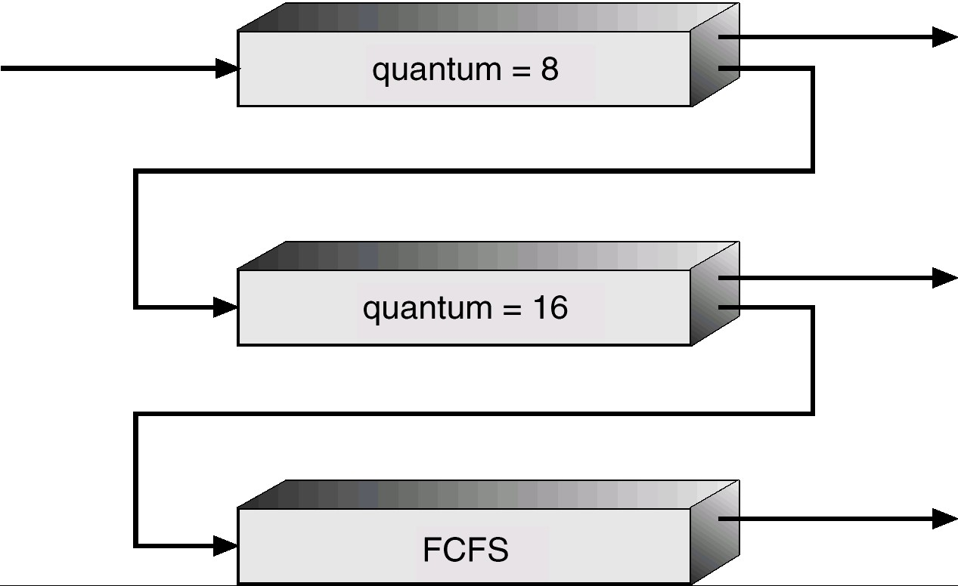
Multilevel Feedback Queues – Example
Three queues
Q₀ – RR with time quantum 8 ms
Q₁ – RR time quantum 16 ms
Q₂ – FCFS
Scheduling
A new process enters queue Q₀
When it gains CPU, process receives 8 ms
If it does not finish in 8 ms, process is moved to queue Q₁
At Q₁ process 16 additional ms
If it still does not complete, it is preempted and moved to queue Q₂
Starvation is still possible here!

Slide 46
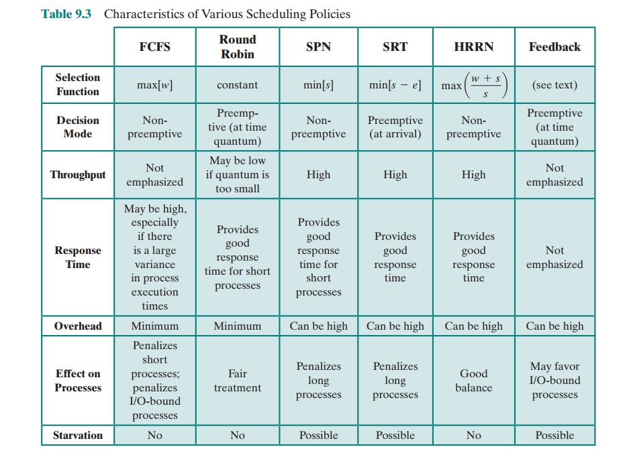
Characteristics of Scheduling policies

Slide 47

Any Question So Far?

